Slide 1
5. Forecasting
ECFI 2019-20
Class 22 April + 24 April 2020

Slide 2
5.2 – Minimum m.s.e. forecasts for ARMA processes
Let’s set up some notation: ${\hat{Z}}_{n+l|n}≡{\hat{Z}}_{n}(l)$
Current period Forecasting horizon
Write it in Wold representation form: $Z_{t}=a_{t}+ψ_{1}a_{t−1}+ψ_{2}a_{t−2}+…+ψ_{k}a_{t−k}+…=\sum_{j=0}^{∞}{ψ_{j}a_{t−j}}$
$$Z_{n+l}=a_{n+l}+ψ_{1}a_{n+l−1}+ψ_{2}a_{n+l−2}+…+ψ_{l−1}a_{n+1}+ψ_{l}a_{n}+ψ_{l+1}a_{n−1}+…$$
FUTURE PAST
Then, ${E[Z}_{n+l}|Z_{n}, Z_{n−1, }Z_{n−2, }…]=ψ_{l}a_{n}+ψ_{l+1}a_{n−1}+…$

Slide 3
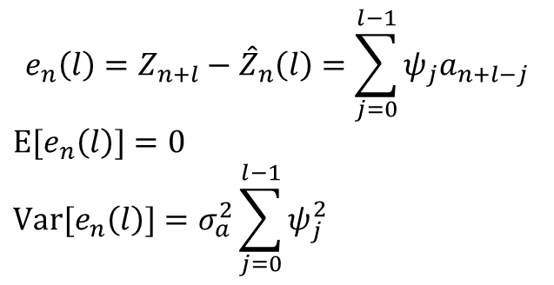
So, ${E[Z}_{n+l}|Z_{n}, Z_{n−1, }Z_{n−2, }…]=ψ_{l}a_{n}+ψ_{l+1}a_{n−1}+…$
Now, to prove this is the minimum m.s.e. forecast for $Z_{n}\left(l\right)$, write the optimal m.s.e. coefficients $ψ_{j}^{∗}$
(we are considering linear forecasts, i.e., linear combinations of past observations)
$${\hat{Z}}_{n}(l)=ψ_{l}^{∗}a_{n}+ψ_{l+1}^{∗}a_{n−1}+…$$
$$E{\left[Z_{n+l}−{\hat{Z}}_{n}\left(l\right)\right]}^{2}=σ_{a}^{2}\sum_{j=0}^{l−1}{ψ_{j}^{2}}+σ_{a}^{2}\sum_{j=0}^{∞}{{\left(ψ_{l+j} −ψ_{l+j}^{∗}\right)}^{2}}$$
This is minimized for ${ψ_{l+j}^{∗}=ψ}_{l+j}$
$$e_{n}\left(l\right)=Z_{n+l}−{\hat{Z}}_{n}\left(l\right)=\sum_{j=0}^{l−1}{ψ_{j}a_{n+l−j}}$$
$${E[e}_{n}\left(l\right)]=0$$
$${Var[e}_{n}\left(l\right)]=σ_{a}^{2}\sum_{j=0}^{l−1}{ψ_{j}^{2}}$$
Forecast error:

Slide 4


Asymptotics:
$$→ \sum_{j=0}^{∞}{ψ_{j}a_{n+l−j}}$$
$$→ σ_{a}^{2}\sum_{j=0}^{∞}{ψ_{j}^{2}}$$
In conclusion:
$$e_{n}\left(l\right)=Z_{n+l}−{\hat{Z}}_{n}\left(l\right)=\sum_{j=0}^{l−1}{ψ_{j}a_{n+l−j}}$$
$${E[e}_{n}\left(l\right)]=0$$
$${Var[e}_{n}\left(l\right)]=σ_{a}^{2}\sum_{j=0}^{l−1}{ψ_{j}^{2}}$$
$$=Var[Z_{t}]$$
For ARIMA we can obtain a similar formulation, but nonconvergent

Slide 5
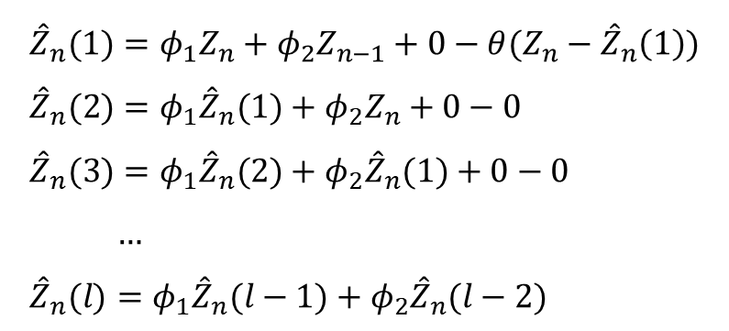
In an ARMA it converges to the mean
Example: ARMA(2,1): $Z_{t}=φ_{1}Z_{t−1}+φ_{2}Z_{t−2}+a_{t}−θ_{1}a_{t−1}$
See also Ex. 5.2 in Wei’s book
$$Z_{n+1}=φ_{1}Z_{n}+φ_{2}Z_{n−1}+a_{n+1}−θa_{n}$$
$Z_{n+2}=φ_{1}Z_{n+1}+φ_{2}Z_{n}+a_{n+2}−θa_{n+1}$
$…$
$${\hat{Z}}_{n}(1)=φ_{1}Z_{n}+φ_{2}Z_{n−1}+0−θ(Z_{n}−{\hat{Z}}_{n}\left(1\right))$$
${\hat{Z}}_{n}(2)=φ_{1}{\hat{Z}}_{n}(1)+φ_{2}Z_{n}+0−0$
${\hat{Z}}_{n}(3)=φ_{1}{\hat{Z}}_{n}(2)+φ_{2}{\hat{Z}}_{n}(1)+0−0$
$…$
${\hat{Z}}_{n}(l)=φ_{1}{\hat{Z}}_{n}(l−1)+φ_{2}{\hat{Z}}_{n}(l−2)$
Eventual forecasting function

